Slide 1
Computer Lab 2:
Sample Statistics and Hypothesis Testing
SOST20022 Essentials of survey design and analysis 2024-25

Slide 2
Content
The procedure for conducting hypothesis testing in R
Solutions to the exercise
Q&A

Slide 3
Procedure for conducting hypothesis testing
1. Formulate the null and alternative hypotheses (H0 and H1)
2. Calculate the sample statistic and the standard error
3. Calculate the test statistic
4. Compare the test statistic against the null-distribution
5. Make a decision about H0 and H1

Slide 4
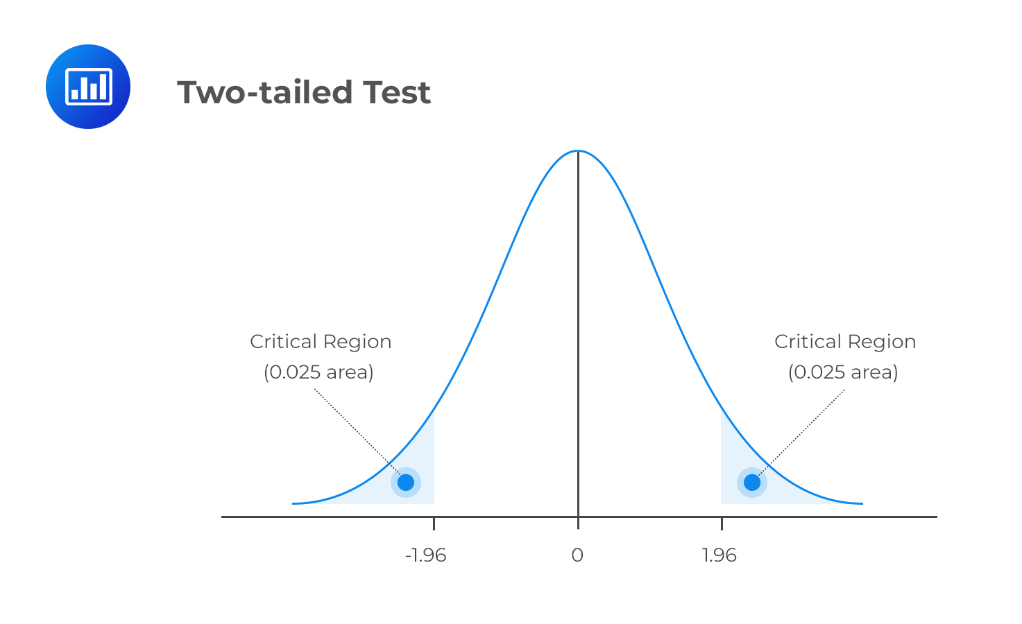

Slide 5

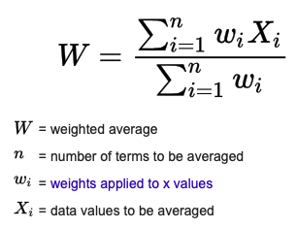
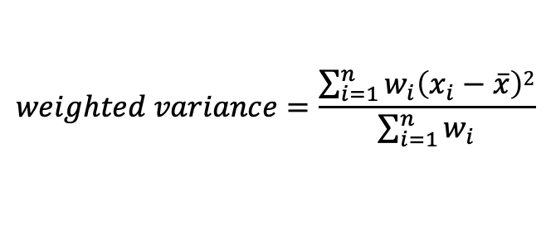
Weighted Variance (population parameter)
$$weighted variance=\frac{\sum_{i=1}^{n}{w_{i}\left(x_{i}−\overline{x}\right)2}}{\sum_{i=1}^{n}{w_{i}}}$$
Notes:
var <- wtd.var(x, wt)
sd <- sqrt(var)

Slide 6
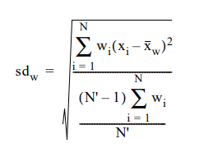
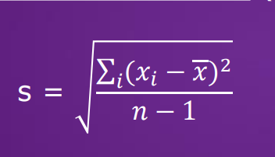
Weighted standard deviation (Sample statistics; consistent estimate)
Unweighted weighted
In R:
var <- wtd.var(x, wt)
sd <- sqrt(var)
Notes:
var <- wtd.var(x, wt)
sd <- sqrt(var)

Slide 7
More Q&A…

